Slide 1

Optimizing SMS Spam Filtering using Machine Learning
* Machine learning is a field of inquiry devoted to understanding and building methods , that mean, methods that leverage data to improve performance on some set of tasks.
* Optimizing Spam SMS filter Using Machine Learning models aims at filtering the Spam SMS and presenting only the required SMS for the users.
* Purpose of this model enable the people to avoid viewing the unwanted SMS messages and all the filtered messages stands important.
* Business Impact: By filtering the Spam SMS , Essential SMS and Detail alone are viewed which we promote the service provider business aspect.

Slide 2

Problem Understanding /business problem
Most of the SMS spam includes commercial advertisements and promotions of service plans. Such SMS distract user.
waste their time in reading and deleting them, flood their inbox.
the intent of hacking or malware attack which imposes higher risk to smartphone users.
Financial Fraud (cheat activity).

Slide 3
Data Set (Source)
In this Project we used a data set (collection of Ham and Spam SMS) for train and test the Model.
For this project we used “.csv” file. This data set downloaded from www.kaggle.com.
For better reference use this link (www.kaggle.com/datasets/uciml/sms-spam-collection-dataset)

Slide 4
Optimizing SMS spam detection
Optimizing SMS spam detection is a popular application of machine learning that can help peoples and environment to avoid the spam SMS and it enable, avoid viewing the unwanted SMS messages and all the filtered messages stands important
The steps involves in this project process.
Data collection
Data cleaning and data preprocessing
Model selection
Model training and testing
Deployment
User interface (ready for checking )

Slide 5
Data Preprocessing for optimizing Spam SMS
The data set is taken from www.kaggle.com and the following process is done.
Handling missing values
Handling categorical data
Handling outliers
Scaling Techniques
Splitting dataset into training and test set
Categorical data
Handling outers
Scaling techniues
Training set and test data
Handling missing values

Slide 6
Data Attribiutes
stop_words , message , labels , spam_words , ham_words , ham_messages , spam_message , SpamCount , HamCount .
acc_scorer , svc_clf .

Slide 7
Model training and Evaluation
Model Selection: There are many different machine learning algorithms that can be used for Optimizing SMS spam filtering , such as linear regression, decision trees, random forests, and neural networks. The choice of algorithm will depend on the complexity of the problem, the size of the dataset, and the desired level of accuracy.
Model Training: Once a model has been selected, it can be trained using the training set. The model will learn to predict Spam SMS based on the input features. The training process typically involves optimizing the model's parameters to minimize the difference between the predicted and actual data set.
Model Evaluation: After the model has been trained, it can be evaluated using the testing set. This involves comparing the predicted ham SMS s to the spam SMS and calculating metrics such as mean squared error (MSE). These metrics provide an indication of the model's accuracy and can be used to compare different models.

Slide 8
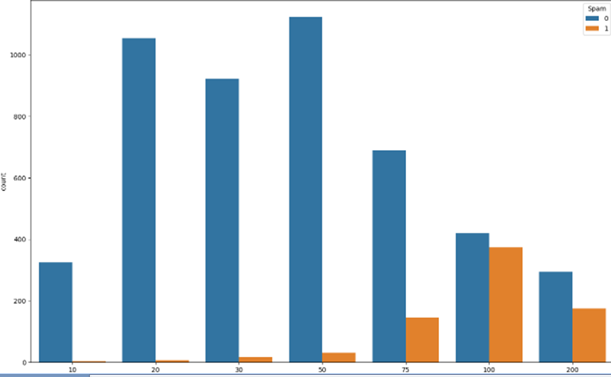
Result

Slide 9
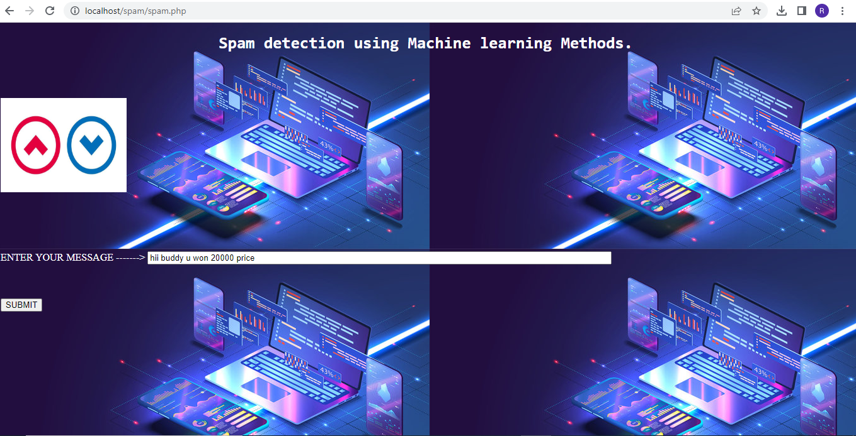
User interface

Slide 10
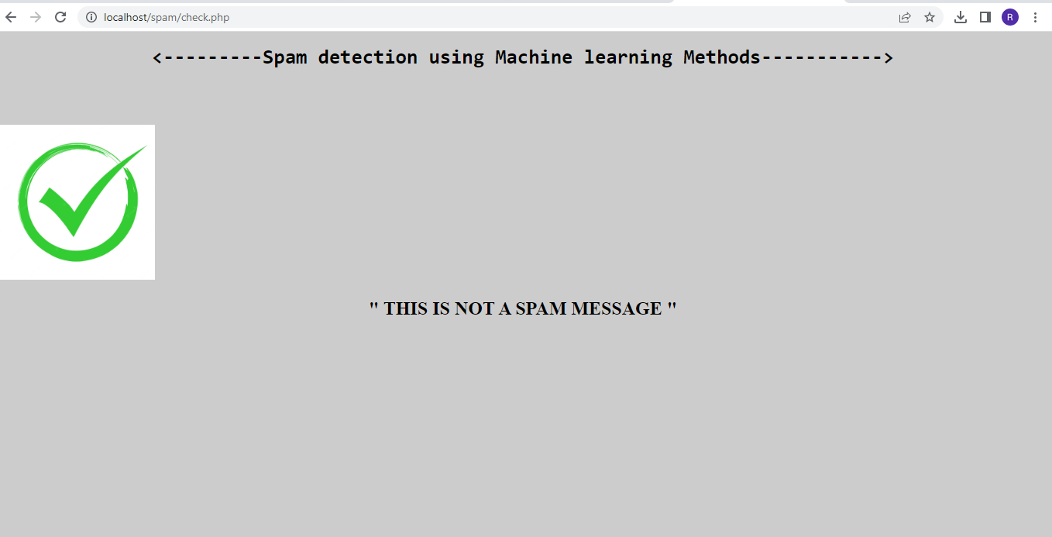
Result

Slide 11
Conclusion
* In this end-to-end project we have learned how to approach a problem statement, and gather useful conclusions from the data using Data preprocessing, Data Visualisation which will help you build a good Machine Learning Model.
So , In our project( this application model )will be used or model enable the people to avoid viewing the unwanted SMS messages and all the filtered messages stands important . so we can use this model as a application in client androids and devices.
This protects the user from any potential cyber threat and facilitates smooth communications and workflow
Conclusion

Slide 12
Future Scope
The future of SMS spam filtering using machine learning could involve incorporating more advanced techniques such as deep learning and natural language processing to further improve the accuracy of spam detection. Additionally, personalized spam filtering could be developed based on individual user preferences and message history. Overall, the application of machine learning to SMS spam filtering has the potential to greatly improve the user experience and reduce the annoyance and security risks associated with spam messages.
In the future, we plan to deal with more challenging problems such as the analysis and management of report in spam SMS filters storing. Solution for this problem is another focus of work in the
Future

